Slide 1


VARDHAMAN COLLEGE OF ENGINEERING, HYDERABAD
Autonomous institute affiliated to JNTUH
DEPARTMENT OF CSE(AI&ML)
IV-Year Major Project Abstract Level Review
Title: Automated Curriculum Design Using LLMs
Domain: Quality Education and Skill Development
BATCH ID : 32
S. No | Roll. No | Student Name
1 | 23881A6671 | B.Hansika Reddy
2 | 23881A66A3 | P.Shravani Mudhiraj
3 | 23881A66B8 | Tashifa Nooreen
Supervisor
Mr.N.S.S.S.Girish Kumar
Assistant Professor
Department of CSE(AI&ML)

Slide 2
Outlines
Abstract
Introduction
Literature Review
Existing System with Pros and Cons (comparison with existing systems- Table)
Problem Statement
Objectives & Expected Deliverables
SDG Mapping
PO Mapping
PSO Mapping
Timeline
References

Slide 3
Abstract
Automates curriculum design using Large Language Models (LLMs).
Generates course objectives, module-wise content, and learning outcomes based on user inputs.
Creates weekly learning plans, project ideas, and recommended learning resources.
Reduces manual effort, time, and inconsistencies in curriculum development.
Allows educators to review and customize the generated curriculum.
Supports personalized, high-quality, and up-to-date curriculum development for educational institutions.

Slide 4
Introduction
Curriculum design is a fundamental process that defines course objectives, learning outcomes, and learning content.
Traditional curriculum development is manual, time-consuming, and requires frequent updates.
Rapid technological advancements demand industry-relevant and up-to-date curricula.
Large Language Models (LLMs) can automate curriculum generation by creating structured learning plans from user inputs.
The proposed system aims to reduce educator workload while generating consistent, customizable, and high-quality curricula.

Slide 5
Literature Review
Recent studies show that Large Language Models (LLMs) can effectively support curriculum and instructional design.
AI-based systems automate the generation of course content, learning outcomes, and teaching plans, reducing manual effort.
Multi-agent and LLM-based approaches improve the quality and personalization of educational content.
Existing methods have limitations such as high computational cost, limited scalability, and dependence on input quality.
The proposed project addresses these limitations by developing an AI-powered system for automated, customizable curriculum generation.

Slide 6
Existing System
Curriculum is designed manually by educators and academic experts.
Preparing course objectives, modules, assessments, and learning resources requires significant time and effort.
Updating curricula to match new technologies and industry requirements is a slow process.
Manual curriculum design may lead to inconsistencies and lack of standardization across courses.
Limited support for personalized learning and rapid curriculum generation.

Slide 7
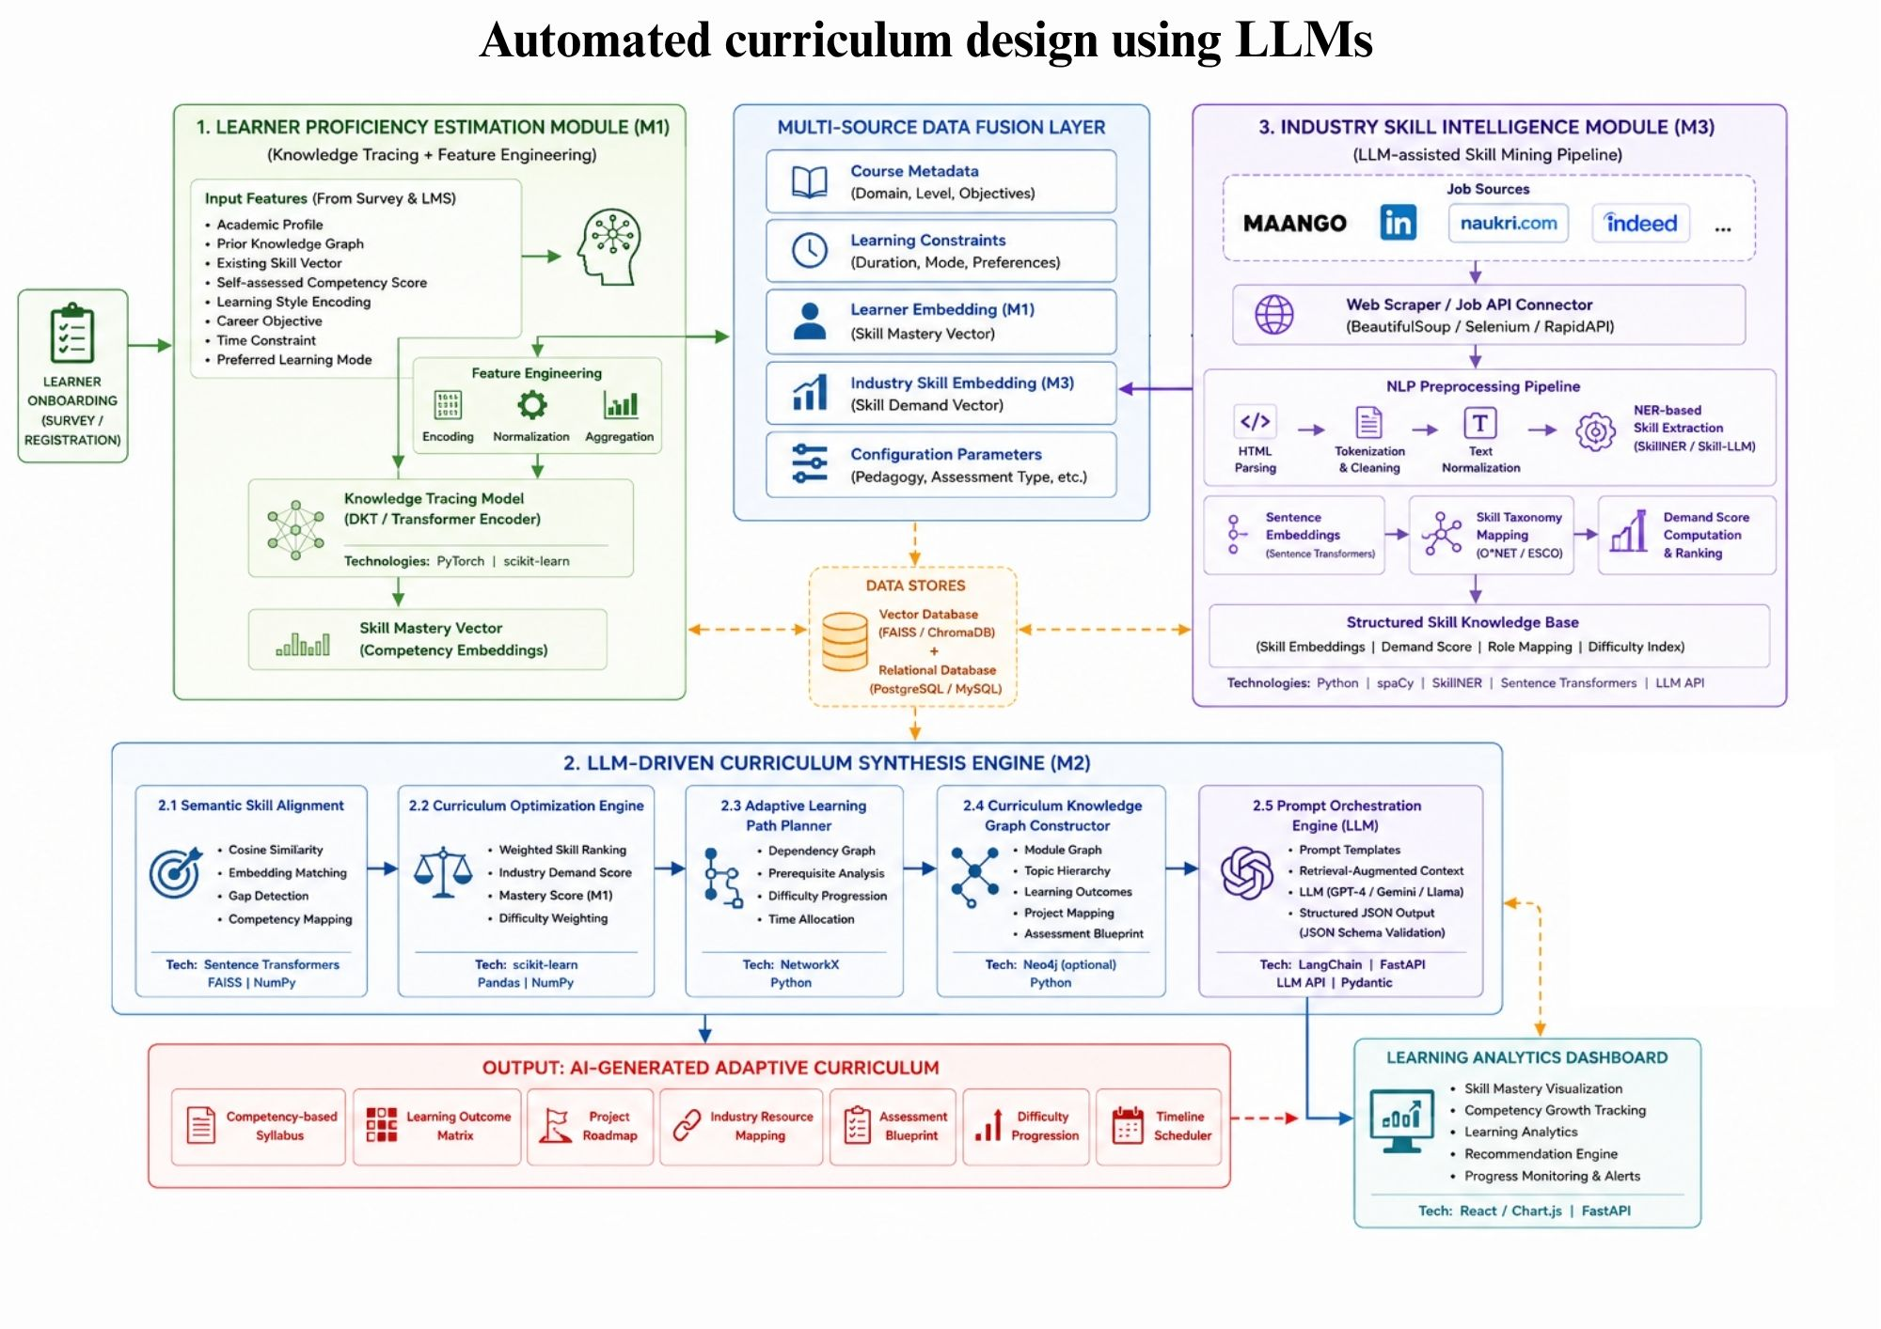
Flow Diagram/Architecture

Slide 8
Methodology
Frontend: HTML, CSS, JavaScript (or React, if a framework is used).
Backend: Python with Flask or FastAPI.
Database: SQLite / MySQL / PostgreSQL.
AI/ML Stack: Python, scikit-learn, PyTorch/TensorFlow (for Model 1 and Model 3), Hugging Face / LLM API (for Model 2).
LLM Integration: OpenAI GPT / Google Gemini / open-source LLM (e.g., Llama, Mistral) via API.
Deployment: Local server or cloud (e.g., Render, Railway, AWS).
Tools: Git, GitHub, Jupyter/Colab, VS Code.

Slide 9
Methodology
Model 1 – Student Proficiency Model
Type: Deep learning / ML model for knowledge tracing.
Input: Student quiz/assessment results (correctness, time, attempts).
Output: Skill-wise mastery scores for each student.
Possible approach: DKT-style RNN/transformer or a simpler gradient-boosted model over engineered features.
Model 2 – Curriculum Design Model
Type: LLM-based generator (possibly fine-tuned or prompted).
Input: Course topic, level, duration, learning objectives, and industry skill set.
Output: Structured curriculum (modules, learning outcomes, topics, assessments, resources).
Possible approach: Prompted LLM with structured output schema, optionally fine-tuned on lesson-plan datasets.

Slide 10
Methodology
Model 3 – Industry Relevance Model
Type: NLP/LLM-based skill extraction and ranking model.
Input: Job descriptions from Mango, LinkedIn, etc.
Output: Structured list of required skills, tools, soft skills, and demand scores.
Possible approach: LLM or NER-based skill extractor (inspired by SKORE/Skill-LLM/SkillNer), followed by aggregation and ranking.

Slide 11
Pros and Cons of Existing System
Pros | Cons
Ensures expert review and academic quality. | Time-consuming and labor-intensive process.
Can be customized to institutional requirements. | Difficult to update with evolving technologies and industry needs.
Provides better human judgment in curriculum planning. | Lack of consistency and standardization across curricula.
Well-established traditional curriculum development process. | Limited personalization for different learner levels.
Familiar workflow for educators and institutions. | Requires significant manual effort and frequent revisions.

Slide 12
Problem Statement
Manual curriculum design is time-consuming and labor-intensive.
Frequent curriculum updates are required to keep pace with evolving technologies and industry demands.
Manual development leads to inconsistencies and increased workload for educators.
Existing systems provide limited personalization for different learner levels.
There is a need for an AI-based automated system to generate structured, customizable, and up-to-date curricula efficiently.

Slide 13
Objectives & Deliverables Proposed System
Objectives:
Develop an AI-based system for automated curriculum generation using LLMs.
Generate structured curricula with modules, outcomes, schedules, projects, and learning resources.Provide a customizable and adaptable curriculum framework for educators.
Deliverables:
AI-Based Curriculum Generator: A web application that automatically creates structured curricula using LLMs.
Customizable Curriculum: Allows educators to review, edit, and personalize the generated curriculum.
Complete Curriculum Output: Generates course objectives, modules, learning outcomes, project ideas, and learning resources.

Slide 14
SDG Mapping
SDG No | Goal Title | Justification
4 | Quality Education | The project improves education by generating structured, up-to-date, and personalized curricula efficiently.
9 | Industry, Innovation and Infrastructure | The project uses AI and LLMs to introduce innovation in curriculum design and educational planning.
10 | Reduced Inequalities | The project provides standardized and adaptable curricula for learners with different educational needs.
17 | Partnerships | The project supports collaboration between educators, institutions, and AI technologies to improve curriculum development.

Slide 15
PO Mapping
PO Number | Name of the PO Targeted | Justification
PO1 | Engineering Knowledge | The project applies AI, LLMs, and web development knowledge to automate curriculum design.
PO2 | Problem Analysis | The project identifies the limitations of manual curriculum design and provides an AI-based solution.
PO3 | Design/Development of Solutions | The project develops an intelligent web application for automated curriculum generation.
PO5 | Engineering Tool Usage | Use LLMs, APIs, and web frameworks.
PO7 | Ethics | The project promotes the responsible and ethical use of AI in education.
PO8 | Individual and Collaborative Team Work | The project encourages teamwork and effective collaboration during development.
PO11 | Life-Long Learning | The project promotes continuous learning of AI and emerging technologies.

Slide 16
PSO Mapping
PSO Number | Name of the PSO Targeted | Justification
PSO1 | Apply the knowledge of Artificial Intelligence to design, develop, and evaluate computational solutions for complex problems in diverse domains, such as healthcare, finance, and automation | The project applies Artificial Intelligence and Large Language Models (LLMs) to automate curriculum design and provide an intelligent solution for educational planning.
PSO2 | Demonstrate expertise in using advanced ML tools, techniques, and frameworks to develop innovative solutions for data analysis, pattern recognition, and intelligent decision- making system | The project uses advanced AI tools and LLM frameworks to generate structured curricula, supporting intelligent decision-making and automation.

Slide 17
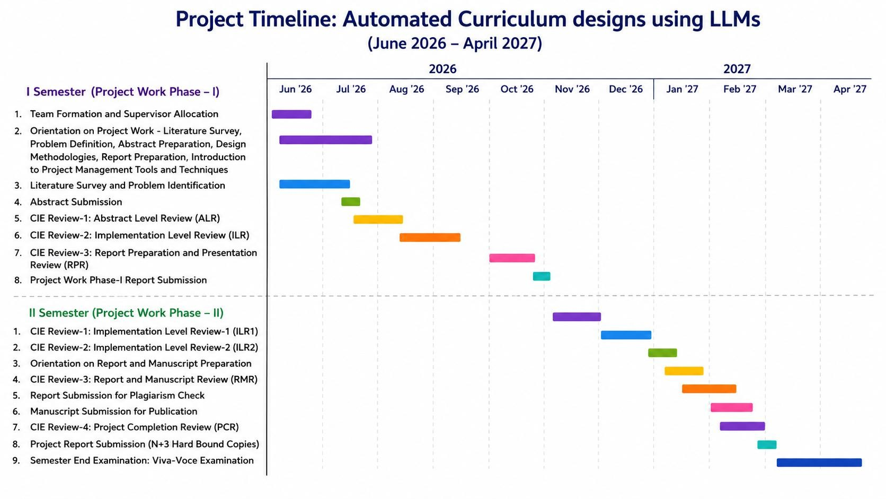
Timelines

Slide 18
References
1. Shi, Y., Yu, K., Dong, Y., & Chen, F. (2026). Large language models in education: a systematic review of empirical applications, benefits, and challenges. Computers and Education: Artificial Intelligence, 10.
2. Rockembach, G. R., Sánchez, M. E. S., & Thom, L. H. (2026). A Systematic LLM-Assisted Approach for Deriving Skills From Competencies: A Case in Business Process Management Education. IEEE Access.
3. Satheesh, A., Powell, K., & Wei, H. (2025). cMALC-D: Contextual Multi-Agent LLM Guided Curriculum Learning with Diversity-Based Context Blending. In Proceedings of the 34th ACM International Conference on Information and Knowledge Management (CIKM ’25).
4. Zhang, X., Zhang, C., Sun, J., Xiao, J., Yang, Y., & Luo, Y. (2025). EduPlanner: LLM-Based Multiagent Systems for Customized and Intelligent Instructional Design. IEEE Transactions on Learning Technologies.
5. Li, S., Xiao, Y., Li, J., & Li, Y. (2025). Automatic Construction System for Curriculum Knowledge Graphs Based on Large Language Models. In 2nd International Conference on Artificial Intelligence and Future Education (AIFE 2025).
6. Ryu, K., Liao, Q., Li, Z., Delgosha, P., Sreenath, K., & Mehr, N. (2025). CurricuLLM: Automatic Task Curricula Design for Learning Complex Robot Skills using Large Language Models.
7. Song, T., Zhang, H., & Xiao, Y. (2024). A High-Quality Generation Approach for Educational Programming Projects Using LLM. IEEE Transactions on Learning Technologies.
8. Hu, B., Zheng, L., Zhu, J., Ding, L., Wang, Y., & Gu, X. (2024). Teaching Plan Generation and Evaluation With GPT-4: Unleashing the Potential of LLM in Instructional Design. IEEE Transactions on Learning Technologies.
9. Zhou, Y., Liu, Z., & Dou, Z. (2024). Boosting the Potential of Large Language Models with an Intelligent Information Assistant. In 38th Conference on Neural Information Processing Systems (NeurIPS 2024).
10. Huovinen, L., & Hämäläinen, M. (2024). LLM-Assisted, Iterative Curriculum Writing: A Human-Centered AI Approach in Finnish Higher Education.

Slide 19


